Slide 1

Maine vs National Medicare Payments

Slide 2
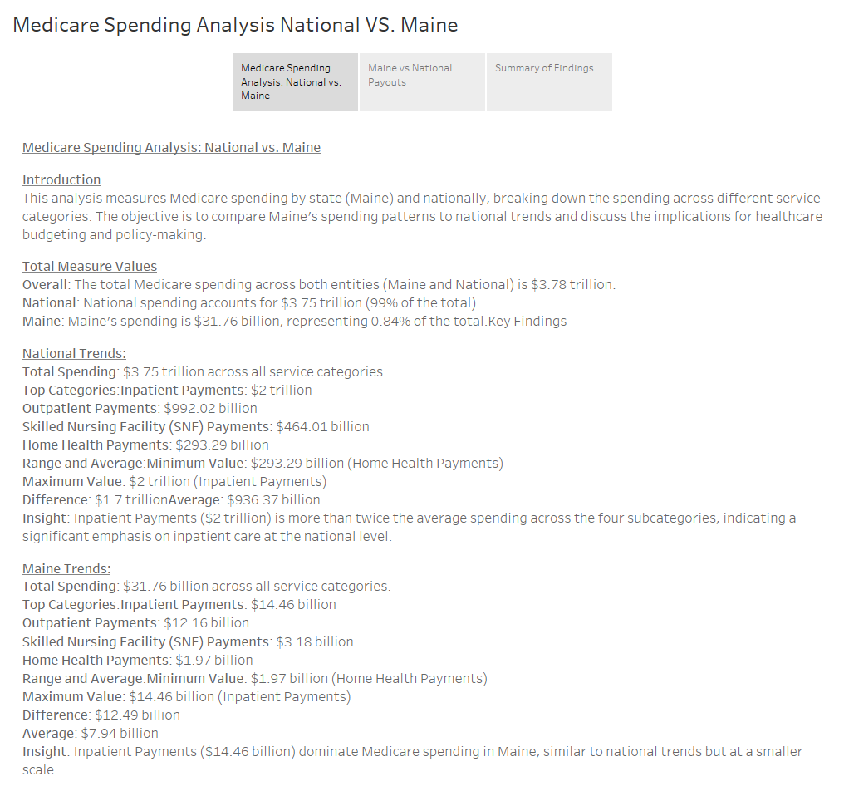

Slide 3
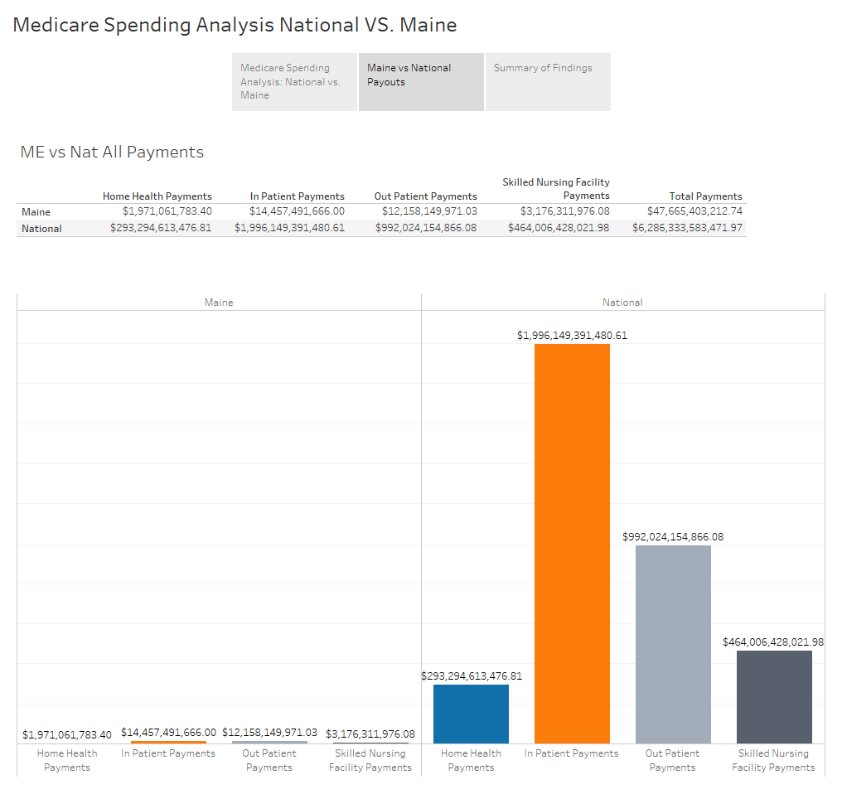

Slide 4


